Slide 1
Flooding

Slide 2
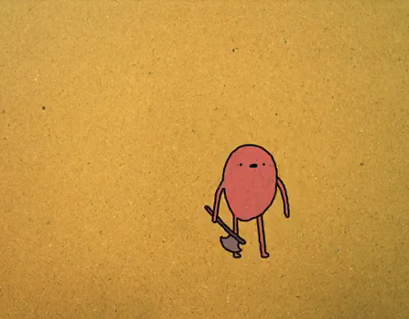
By the end of the lesson, you should be able to:
1. | Identify what flooding is.
2. | Describe some environmental hazards of flooding.
3. | Describe some environmental benefits of flooding.

Slide 3
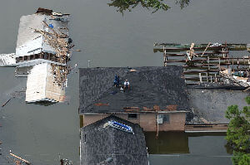
Flooding happens when excessive rainfall causes rivers to overflow into the surrounding land.
Flooding is particularly common in the north-east of Australia, especially in the state of Queensland.

Slide 4
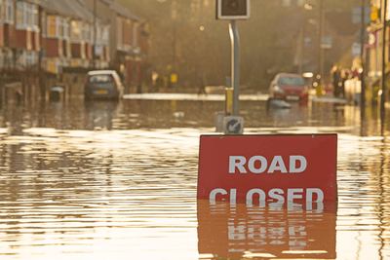
Brisbane and several other cities were flooded in 2011.
Heavy rainfall across Queensland caused many rivers to overflow and spread across the land.
Water that flows across land as a result of flooding is called run-off. In large floods, the run-off carries huge volumes of sediment (dirt and sand) with it.

Slide 5
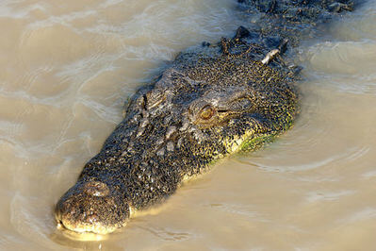
Plants that aren't drowned by the rising water are often buried by sediment settling on top of them.
Small animals can drown in flood waters, but they also bring aquatic animals like snakes, crocodiles and sharks from the rivers. The presence of these predators was a major concern during the flooding of Brisbane.

Slide 6
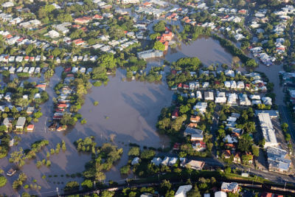
Run-off can also be contaminated by things like raw sewage, disease-carrying pathogens or even radiation.
A tsunami in March 2011 flooded much of eastern Japan, including the Fukushima nuclear power plant. The surrounding area is still showing high levels of radioactivity.
Floods bring many hazards with them. Even when the water stops flowing, there is still the danger of losing your home or catching a disease from what's left behind.

Slide 7
The effects of flooding goes further than just a lot of water.
Run-off from flooding often accumulates sediments, nutrients and harmful chemicals like pesticides from the surrounding land, all of which have significant impacts on ecosystems.
Sediments build up in shallow areas, burying and choking producers, which limits their ability to photosynthesise and provide energy for consumers. Therefore, organisms in every trophic level suffer.

Slide 8
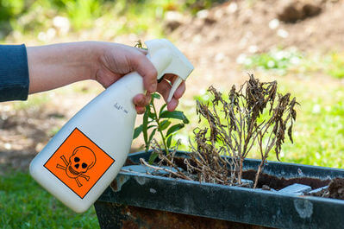
Sometimes, humans can make the damage of flooding worse.
Pesticides are poisonous to many organisms, not all of them pests. If animals drink contaminated water, the pesticides may kill them or be passed onto predators that eat them.
Pesticides and other chemicals build up in the bodies of predators until they become lethal, removing those predators from the food web.

Slide 9
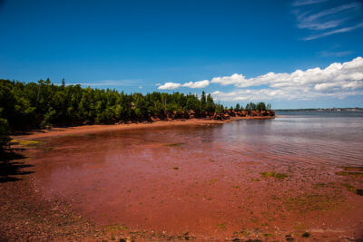
Flooding can move nutrients both from waterways and into waterways.
Excess nutrients in the waterways can cause single-celled algae to grow rapidly into toxic algal blooms. These blooms block out light and soak up all the oxygen in the water, killing other organisms around them.

Slide 10
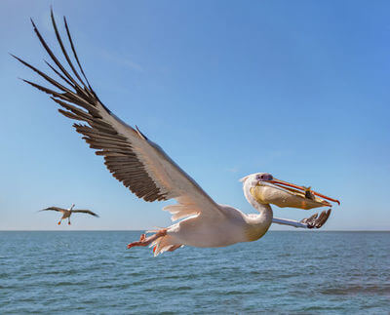
Flooding can help some areas, especially ones affected by drought.
The floods that filled Lake Eyre in 2011 ended a dry spell that lasted for almost a decade. The lake exploded with life, which attracted 80% of Australia's majestic pelicans.

Slide 11

We have seen that nutrients carried by run-off can produce dangerous algal blooms.
However, if they reach plants in drought-prone areas, they make up a once-in-a-lifetime meal. Plants like cacti and mouse-ear cress (Arabidopsis thaliana) use them to flower, reproduce and grow.
In a sense, floods are what bring life to these areas, even though they cause massive damage elsewhere. In the long run, they keep many of Australia's desert ecosystems ticking.

